Slide 1

The Ethics and Economics of Environmental Protection
9. Radical perspectives II: Eco-socialism and environmental justice
Notes:
Note: Revised lecture to reflect student concerns over difficulty.

Slide 2
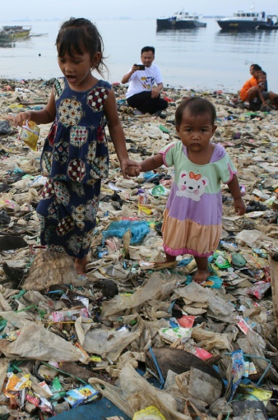
1. The questions of environmental protection
 | Topic | Question
1 | The limits to growth | What are the limits? What would count as “protection”?
2 | Risk, sustainability, and the PP | What is a “reasonable” approach to environmental damage?
3 | Deontology | What is reason, and how far does it go?
4 | Utilitarianism | Is there more to consequentialism than (utilitarian) CBA?
5 | Economic principles | What is an efficient environmental rule?
6 | Economic tools | How do we realise efficient rules in the world?
7 | Democratic theory and environmental protection | Does democracy provide an alternative mechanism to economic tools?
8 | Deep green approaches | Can we overcome humanity’s alienation from nature (and is that really the problem?)?

Slide 3
Radicals and progress
Freedom through philosophy
The ecological ideal
(vulnerable to exploitation)
The humanist ideal
N = 1
N = too many
The question of reason (how many reasons will count?)
N = 1
N = ∞
A preoccupation with ends
A preoccupation with means
Socialist unity – because the answers are simple
Liberal disagreement—because the answers can’t be found
Freedom through action

Slide 4
After the revolution…?
 | Activism + democracy
Aim | To decide universal ends
Mode of reasoning | Normative; aesthetic
Accessibility | Open; deliberative
Socialist economics
To identify efficient means
Empirical, “analytical”
Epistemically exclusive
Boom
Viva la revolution!
Great stuff!
A black box
Troublesome—isn’t this exactly how decisions are taken now?

Slide 5
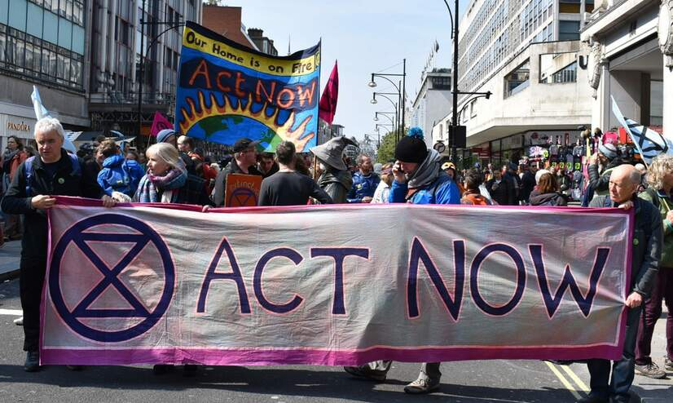
2. Environmental values I: Natural goods
Central to ecosocialism is the claim that ecological values are occluded by capitalist power
Environmental sustainability
Economic activity should be oriented to human needs and balanced by environmental needs
Democracy
Political power should be decentralised to communities and workers
Autonomy
Social institutions would be premised on shared values, not on the arbitrary need to grow

Slide 6

Environmental values II: Emancipation & racism
Critics of capitalism have in recent decades argued that it exploits not only the workers as such, but also racialised groups
Racism is perpetuated by structures that distribute resources and opportunities unequally
The capitalist requirement for profit leads to racial iniquities and power disparities being exploited separately from the working class
The effect is to create structurally weakened populations and groups who are exposed to greater risks from damage, and have a reduced capacity to recover
E.g., the devastation caused by Hurricane Katrina; the disaster at Flint; the expropriation of indigenous groups; exposure to road pollution in the UK
Any anti-capitalist solution must therefore prioritise the standpoints of oppressed groups

Slide 7
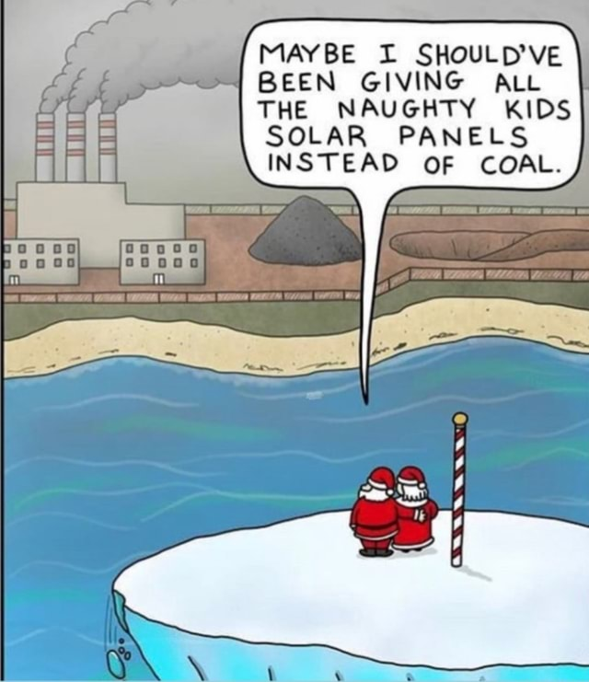
Justice and socialism in the Anthropocene
These arguments overlap substantially in contemporary accounts of how we must adapt in the Anthropocene
Environmental justice as such has tended to focus on the disproportionate impact of pollution and degradation on the marginalised
In recent years, attention has shifted to “ecological” justice, which includes concern for biocentric values and more emphasis on global inclusion and procedural fairness
What’s behind the shift here?
The recognition that the impacts of individual human behaviour are not only felt across society, but around the world
An increasing awareness that human impacts on the environment may have extreme consequences for future generations
A recognition that human and ecological systems are inextricable, and that human flourishing requires that environmental systems and animals must be a part of our reasoning over justice
The Anthropocene: Full of regrets

Slide 8

3. So what would happen after the revolution?
Or, how would economic decisions be made?
The question of hidden causes
The question of unintended consequences
The question of coordination
The dilemma: after the revolution these decisions would have to be taken by ordinary citizens; but they are social science questions
Would citizens be social science experts (better than our current experts?)
Or would social science be superfluous (e.g., because we would have realised post-scarcity)?
Would it be possible to avoid the division of labour provided either by the technocratic state or the competitive market?

Slide 9
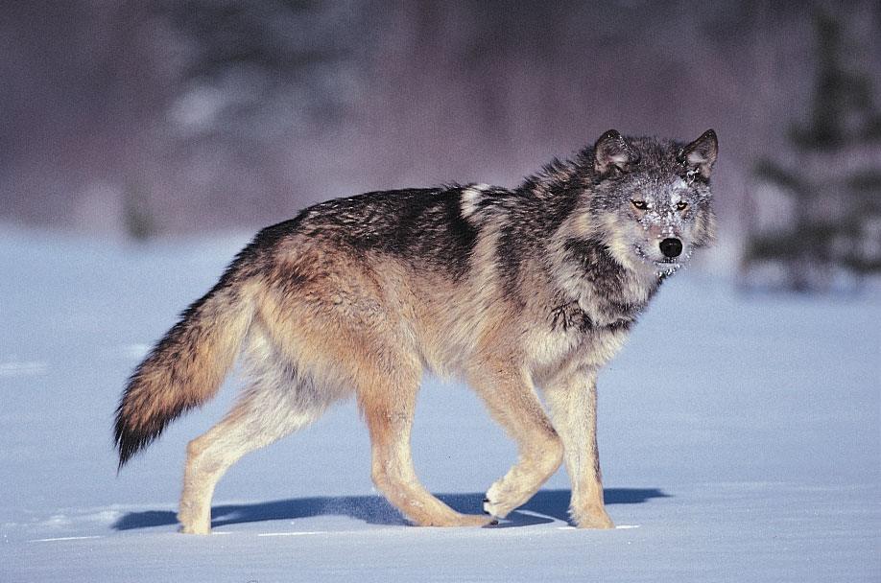
Variations on a critique
Freedom through mutual respect
The humanist critique
Socialists and market liberals alike misunderstand the person, who is necessarily an interpretive creature
Individuals act for (often surprising) reasons, not because of objective interests or natural causes
This makes behaviour largely unpredictable, whether the policymaker is the citizen or the expert
Freedom in an uncertain world cannot mean freedom from coercion, but it can mean having the capacity to exit from degrading and inappropriate circumstances
I may not know which policies would realise (or harm) my values, but I do know when I am not being respected, or when a social arrangement just isn’t working for me
The one crucial benefit of capitalism is surely that it (albeit imperfectly) allows us to escape personally bad situations, without having to ask permission. Are we sure we’d be willing to give that up?
The question of life’s purpose
Reaso(n) tends to infinity
The neoliberal critique
Markets rely on cooperation as much as competition; removing the latter in fact hinders the former
The benefit of competition is that it allows us to identify better or worse solutions to problems
Competition also protects us from exploitation, because it allows us to exit unfair terms of cooperation
Order in an uncertain future requires abstract rules in which multiplicity can flourish
This is true in nature—evolution, for instance, is not something that can be centrally managed
The market is likewise an evolutionary or “multi-purpose” instrument that allows for redundancy and learning
But it does so only because market actors do not have to get agreement from the community as a whole before they are able to try an experiment
Freedom through efficient coordination

Slide 10

4. Summary
Eco-socialism and environmental justice arguments remind us of our fundamental questions:
What exactly are the environment’s limits? How do they combine scientific and social processes?
How can we efficiently sustain our social and ecological values?
The appeal of these theories is that they identify compelling (social and political) problems
Ecosocialism asks us to reconsider the cheap way in which growth-obsessed policies treat the environment
Anti-racists ask us to bear in mind the invisible and endemic obstacles that minorities face, and the environmental harms these expose us to
Ecological justice theorists ask us to consider the multidimensionality of our effects on the environment (and one another)
However it is possible to challenge them on the grounds that they fudge the mechanism question
Fundamentally, the neoradical (like the old-school ecologist) relies on the people just knowing how to effectively realise efficient behavioural changes, relative to their goals—we saw this with regards to “standpoint epistemology”
Maybe the neoradical is right—but this raises the problem of how to explain disagreement. Do (e.g.) neoliberals take the positions they do because they are motivated to harm the public good?
In any case, this (arguable) failure is not exclusive to eco-socialism and environmental justice: neoliberal economics also relies on some difficult assumptions
Is there a humanist alternative to the economistic ones that dominate environmental protection?

